Slide 1


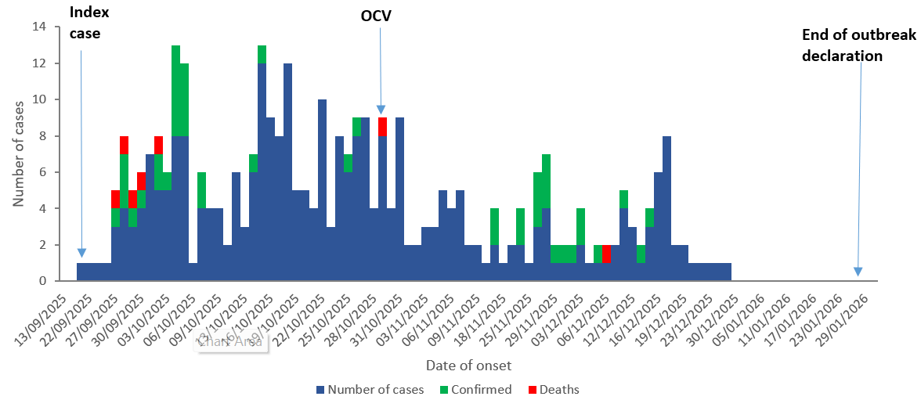
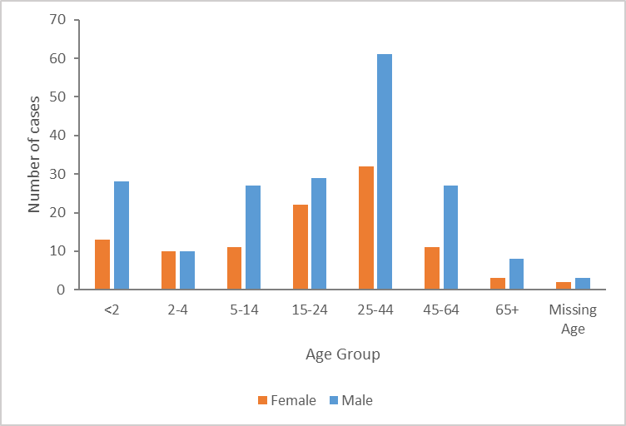
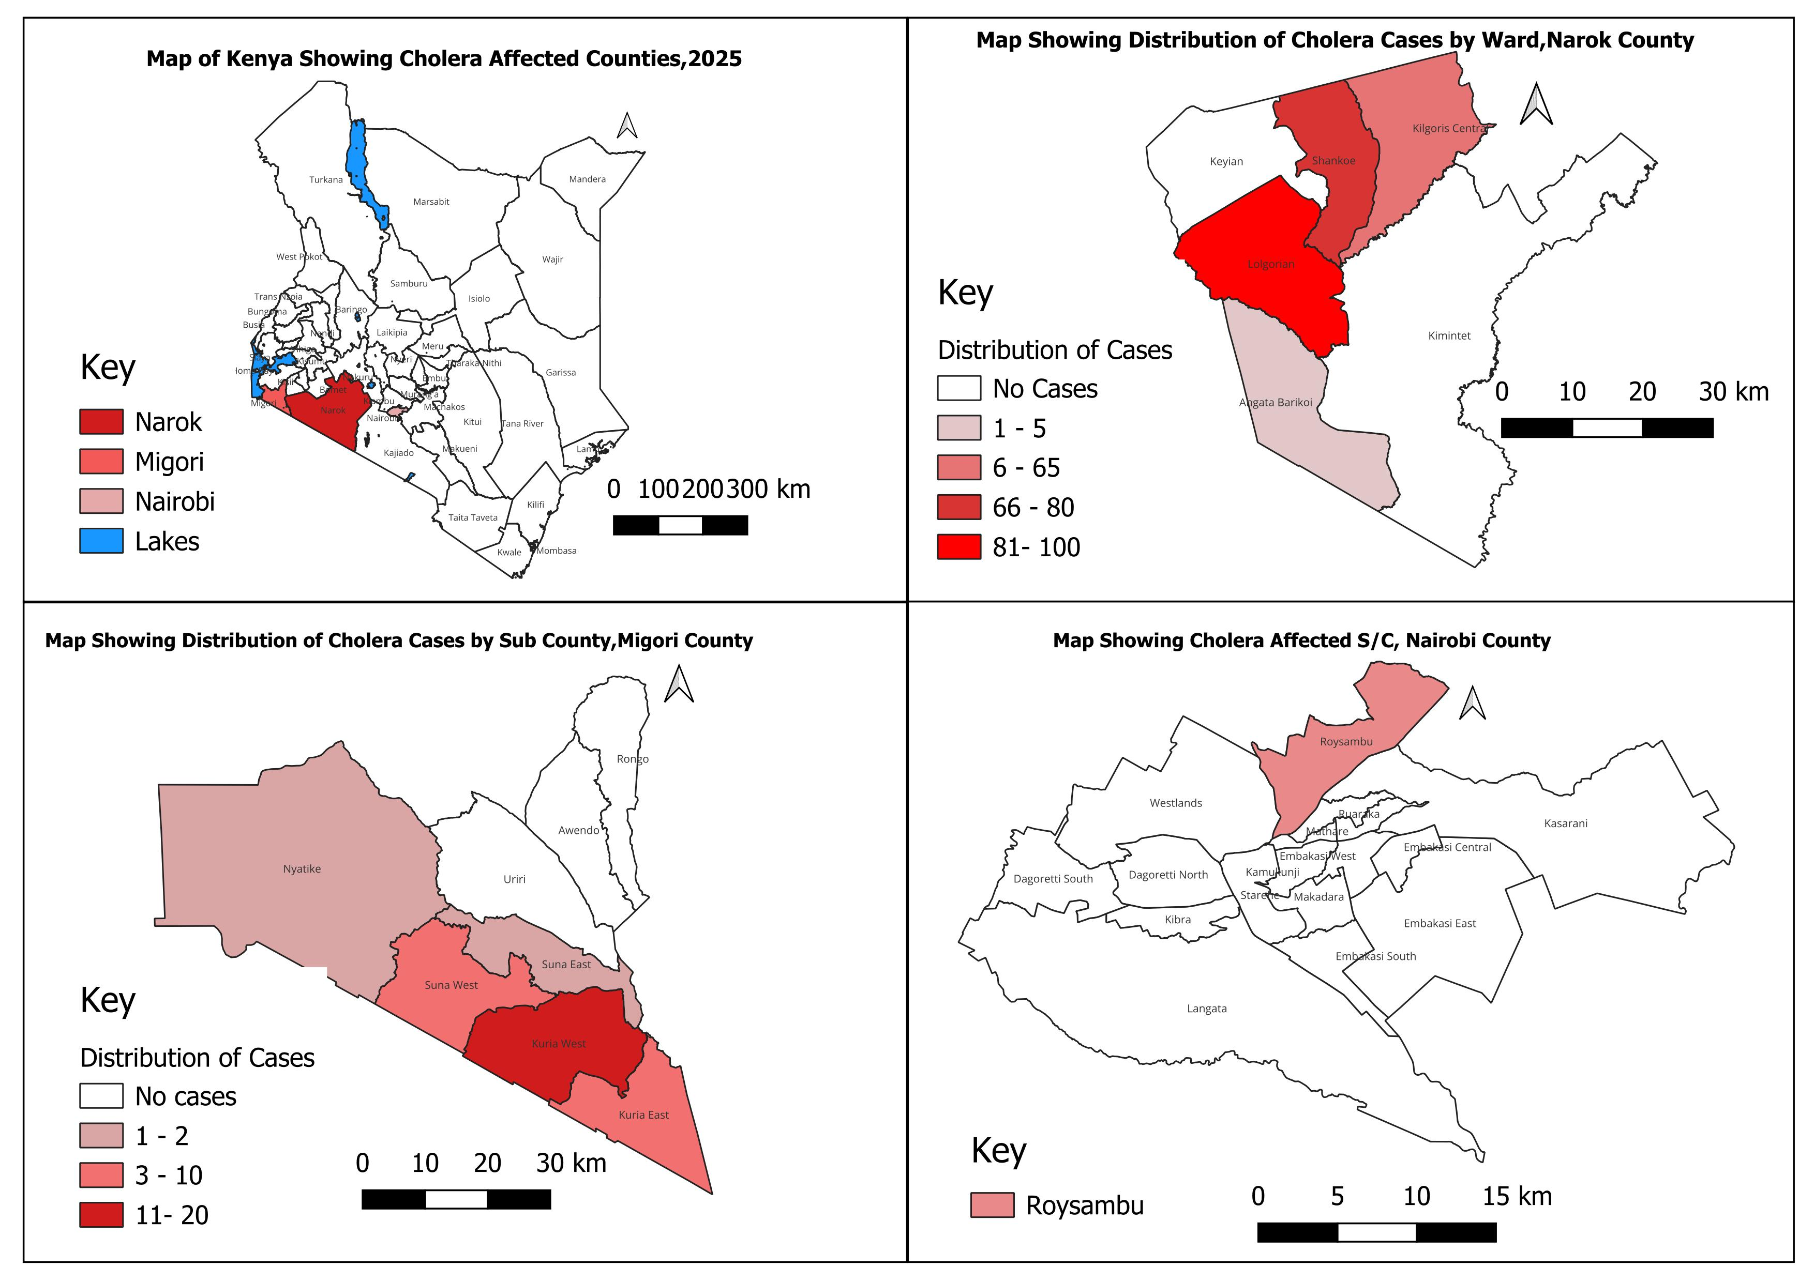



Interrupting Cholera Transmission in Kenya: Lessons from a Multi-County Outbreak Response in Narok, Migori, and Nairobi, September – December 2025
Valentine Kabita¹*, Michelle Wangui¹, Elizabeth Nzioka¹, Francis Ng’ang’a³, Wycliff Matini³, Samuel Kadivane², Gladys Mutethya¹, Catherine Kiama⁴, Ngina Kisangau⁴, Francis Muoka¹, Kanana Kimonye², Emmanuel Okunga²
1:National Public Health Emergency Operations Center-KNPHI, Ministry of Health, Nairobi, Kenya 2:Kenya National Public Health Institute (KNPHI), Ministry of Health, Nairobi, Kenya 3:Division of Disease Surveillance and Response-KNPHI, Ministry of Health, Nairobi, Kenya 4:Washington State University (WSU), Nairobi, Kenya, 5:World Health Organization (WHO), Nairobi, Kenya
BACKGROUND
Cholera remains a significant public health threat in Kenya
Higher risk in areas with limited access to safe water, sanitation, and hygiene (WaSH)
In September 2025, a cholera outbreak was detected in Narok County
Spread reported to Migori County. Nairobi reported an isolated case with no confirmed epidemiological linkage
RESULTS
All 100% (12) of sampled water sources were contaminated (E.coli/coliforms)
Narok’s OCV campaign achieved 93.7% (239,341/255,313) coverage. PSC 94.1%
OBJECTIVE:
To describe the epidemiological characteristics of the cholera outbreak by person, place, and time
To document the key response interventions implemented
METHODOLOGY: Retrospective descriptive analysis
We conducted retrospective analysis of the national cholera line-list for September-December 2025,
Calculated descriptive statistics, reviewed outbreak investigation reports, Incident Management System Team (IMST) meeting-minutes, Oral Cholera Vaccination (OCV), post-OCV coverage Survey (PCS), and Intra-Action Review (IAR) reports to identify interventions implemented, outbreak drivers, and response challenges.
Figure 2: Epi Curve of Cholera Outbreak in Kenya, Sept 2025 - Jan 2026
STUDY AREA: Narok, Migori, and Nairobi counties, Kenya
Figure 3: Distribution of cholera cases by age group and sex in Kenya, Sept 2025-Jan 2026
DISCUSSION
The 25–44 age group was most affected - economically active population
Higher proportion of cases among males - occupational exposure
Rapid activation of the NPHEOC and establishment of the IMS facilitated coordinated response actions
Weekly national coordination meetings enhanced information sharing, decision-making, and resource mobilization
Integrated interventions (WaSH, RCCE, CATI) likely enhanced community-level control measures
Figure 1: Distribution of cholera cases in Kenya, Sept 2025-Jan 2026
RESULTS
A total of 299 cases and 7 deaths (CFR 2.3%) were reported in Narok, Migori & Nairobi
Narok County reported the highest number of cases; 82% (246)
Twenty-nine (29) cases were laboratory-confirmed
Males accounted for 65% (194) of the cases
National cholera IMS constituted, with weekly national coordination meetings to guide response actions
Interventions included outbreak investigation, active case search, contact tracing, Cholera Treatment Centres, laboratory testing, RCCE, WaSH, inter-county coordination, Case-Area-Targeted-Interventions (CATI), OCV campaign, PCS and IAR.
CONCLUSIONS
A coordinated multisectoral response was implemented, integrating Surveillance, Case management, WaSH interventions, RCCE, CATI, OCV, PCS, IAR)
These interventions likely contributed to outbreak control within three months
Sustaining and strengthening these interventions is critical to preventing future
Contact: valentinekabita@gmail.com

